Slide 1
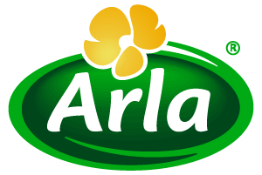
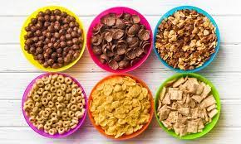
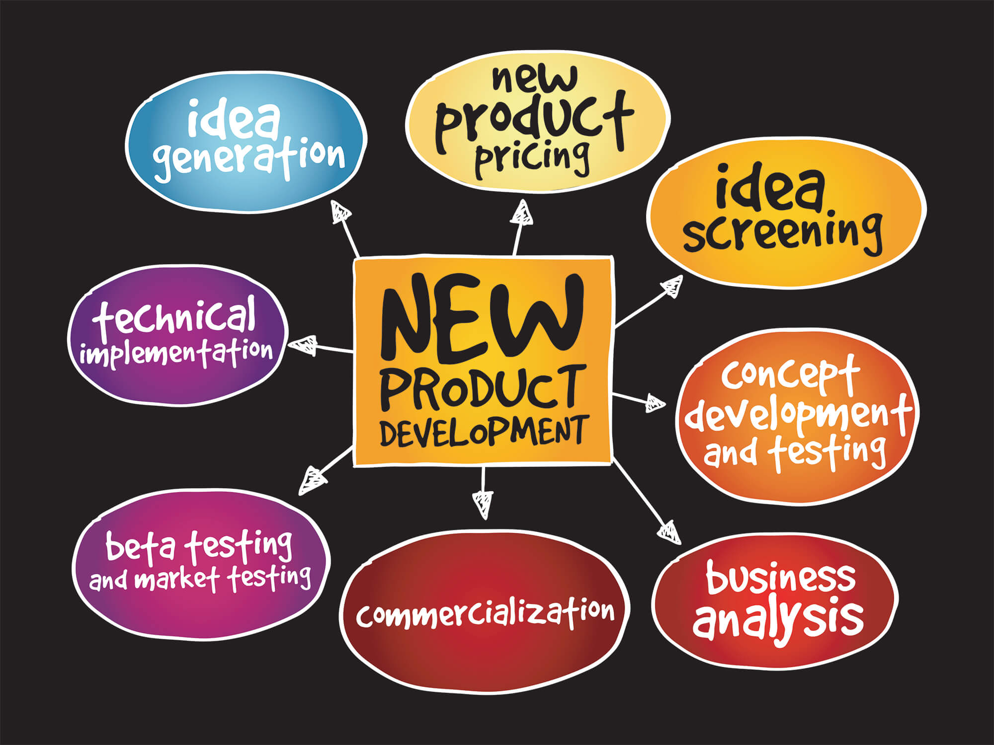
THE BREAKFAST PROJECT; INTRODUCING ARLA CEREALS
STRENGTH
One of the biggest diary companies in the world in terms of volume.
Established, reliable with consumer trust and loyalty hence,
Can thrive on existing prestige thus reducing market entry risk.
Innovative workforce
WEAKNESSES
Arla is known for dairy products only.
OPPORTUNITIES
The global growing cereal market (as at 2016 was estimated to be US$ 37 billion projected to grow to US$ 50 billion in 2030) (Credence research, 2016).
North America and Europe are the largest cereal markets at first and second respectively (Perdon et al., 2020).
The changing consumer needs and increasing awareness for healthier meals and its source.
Cereals are mostly taken with milk in which Arla has gained significance recognition for.
The cereals can be sold alongside the milk as breakfast meals. Some of the cereals will be milk incorporated according to consumer needs.
THREAT
The cereal industry is an oligopoly where very few companies dominate, hence threat to new entrants.
Availability of alternative breakfast options which is perceived cheaper and fresher (such as eggs, toasts etc) than cereal has affected the cereal market (Perdon et al., 2020).
The project
The breakfast project is aimed at introducing a group of cereals into the market through Arla. Arla is the fourth largest diary company in the world in terms of milk volume with its headquarters in Denmark, owned by over 8,600 farmers across Europe (Groholt-Pedersen, 2017). Cereals in western societies is a common breakfast meal made from grain. It is a ready to eat meal (either cold or warm) which is often mixed with milk or yoghurt and more recently fruits and nuts (melanie du puis, 2007). Varieties of cereals will be proposed to meet different consumer needs.
SWOT ANALYSIS
New product development process theory
The development of new product is in stages and has been accepted by several people. The process theory describes a linear model for launching a new product starting with idea generation and ends with product commercialization with profit (Kotler and Armstrong, 2011). This theory will be adapted for Arla in introducing the cereals into the market. This theory will guide in putting a team together to create innovation and strategy for a successful project.
COMPONENTS OF THE PRODUCT
Physical elements
Brand identity
Confidence
Tangible benefits
Quality and guarantee
Psychological benefits
After sale services
Challenges
The supply of ingredient, high commodity and energy cost are major challenges that Arla can face as a player in the cereal industry. Furthermore, the high importance on nutritional properties (such as low fat and sugar) tend to increase the cost of production. This challenge is as a result of technologies required for reducing sugar, salt, or saturated fats and also the cost of adding extra supplements (like fiber and protein) to fortify the cereal (Perdon et al., 2020).
Stages of the project (Gurbuz, 2018)
Summary
Arla a diary company can explore its reliability and customer loyalty to tap into the projected growing cereal market due to its history and acceptance as a breakfast meal. Despite the threat of entry due to the oligopoly in the industry and the challenges of raw materials for improved products, Arla can thrive based on the enormous opportunities through innovative ideas for healthier cereals to gain competitive advantage.
Table 1: Cereal market share value according to company (Gill, 2017)
Company | Approximate Market share (%)
Kellogg’s | 30
General mill | 30
Post | 19
Total | 79

Slide 2
References
Credence research, (2016). Breakfast Cereals Market by Product Type (Hot Cereals, Ready to Eat) e Growth, Future Prospects, Competitive Analysis and Forecast to 2016 - 2023. Available at: https://www.credenceresearch.com/report/breakfast-cereals-market [Accessed 3 August 2022].
Gill, H. (2017). Cold cereals USA: The Top 10 brands in the first half of 2017. Available at: https://www.bakeryandsnacks.com/Article/2017/08/03/Cold-cereals-USA-The-Top-10-brands-in-the-first-half-of-2017 [Accessed 3 August 2022].
Groholt-Pedersen, J (2017). Arla CEO says rising milk supply to keep prices in check. Available at: https://www.reuters.com/article/dairy-milk-arla-idUSL8N1G74TR. (Accessed on 2 August 2022).
Gurbuz, E., 2018. Theory of new product development and its applications. Marketing, pp.57-75.
Kotler and Armstrong, G. (2011). Principles of marketing, 14th edition, New Jersey: Pearson Education.
melanie du puis, E., 2007. Angels and vegetables: A brief history of food advice in America. Gastronomica, 7(3), pp.34-44.
Perdon, A.A., Poutanen, K.S. and Schonauer, S.L., 2020. Breakfast cereals and how they are made—Introduction. In Breakfast Cereals and How They Are Made (pp. 1-4). AACC International Press.
UKEssays. November 2018. New Product Development (NPD) Process Theory. [online]. Available from: https://www.ukessays.com/essays/marketing/new-product-development-process-marketing-essay.php?vref=1 [Accessed 3 August 2022].

